Slide 1

DHHU: Project Gnazim
Presentation by Yarin Benizri Research Assistant at DHHU

Slide 2

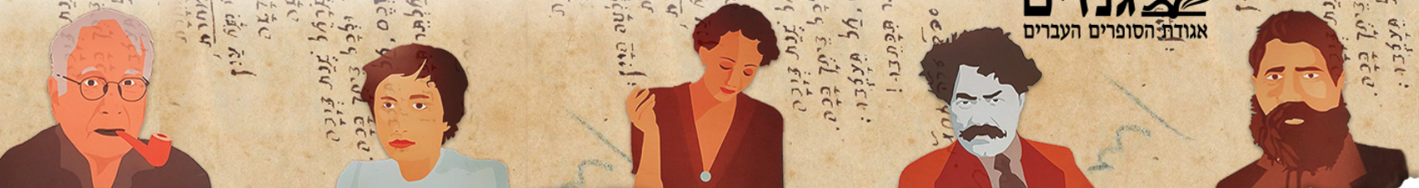
The HUJI Center for Digital Humanities is a comprehensive inter-disciplinary center for the study and research of DH at the Hebrew University. The Center provides a space for training, consultation, collaboration and state-of-the-art research and education in DH. Our goals are to guide and support early-stage research projects, initiate new digital projects, develop tailored tools and methods for scholars in DH, and foster DH literacy among scholars and students of the humanities.

Slide 3
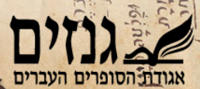
The "Ganzim" Institute of the Association of Hebrew Writers in Israel is the largest archive of Hebrew literature in the world. About 800 archival collections of writers, poets, playwrights, thinkers, editors and writers from the end of the 19th century to the present day are preserved there. This is a huge and rich central collection that reflects modern Hebrew art and the history of the development of culture and art alongside the history of the Jewish people in Israel and around the world.

Slide 4
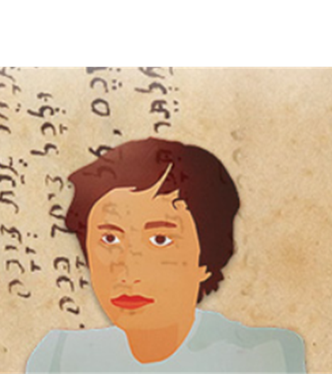
The Task
Our task is to leverage digital humanities tools to extract information from the scanned cards and make this wealth of information readily accessible to the global research community.

Slide 5
Why Its Important?
The 'Gnazim' Institute holds around 800 archival collections, approximately 188,000 cards, was scanned but not include OCR.
The collection is rich and diverse, reflecting the history of Hebrew art and culture, offering insights of great academic value.
Despite its significance, access to this collection is highly restricted; researchers can only peruse the collection by physically visiting the Gnazim Institute. This not only limits accessibility but also hinders research based on this collection.

Slide 6
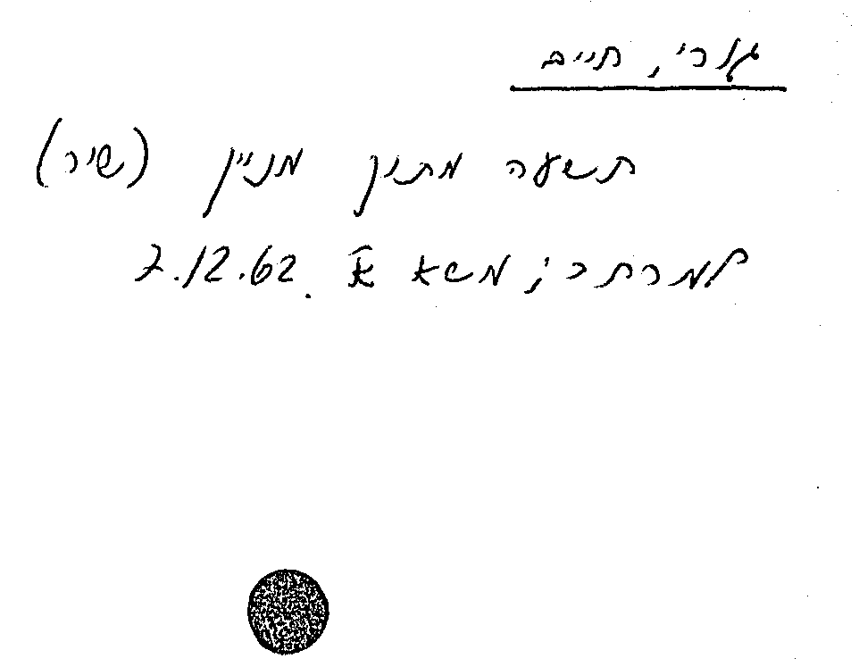
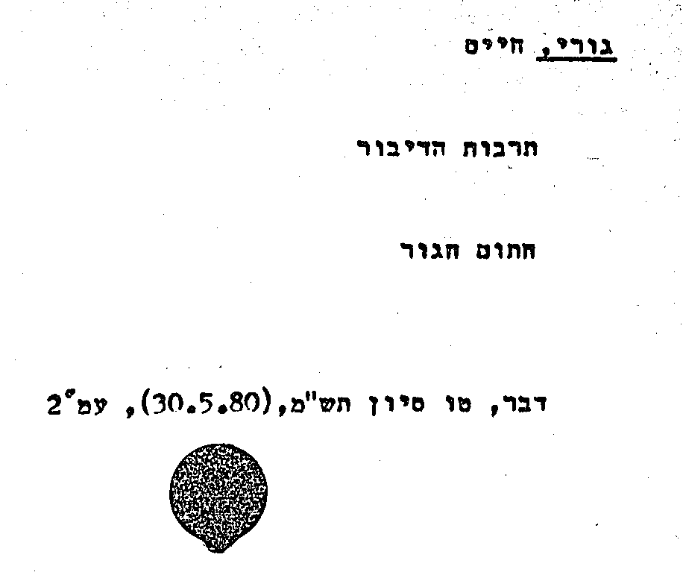
Data Examples
3) Typed, Hand Write, A lot Scan Noise
2)No Typed, Hand write, Little Scan Noise,
1) Typed, No Hand Write, No Scan Noise

Slide 7
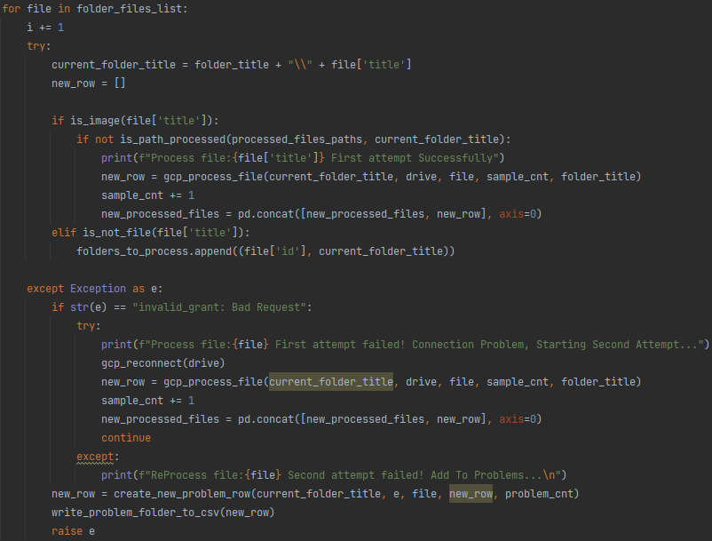
Current Code
Our code is designed to traverse Google Cloud, find un-processed image and download it, apply OCR to it using Tesseract, and extract metadata from folder names.
This process is designed to handle large volumes of data, thanks to the use of Google Cloud Platform, allowing us to process data that cannot be stored on a single machine.
We can process 5k at a single run, we processed over 50k images Overall.

Slide 8
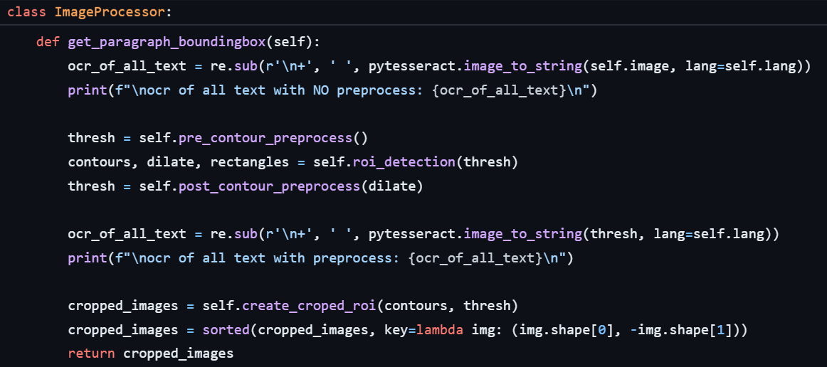
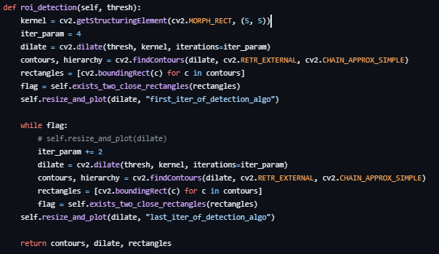
Paragraph Detection
For fast paragraph detection, we chose an image processing method that progressively dilates a thresholded image to merge close contours, identifies these contours, and checks if any two bounding rectangles are close to each other, iterating this process until no closely positioned rectangles are left.
Based on: https://stackoverflow.com/questions/57249273/how-to-detect-paragraphs-in-a-text-document-image-for-a-non-consistent-text-stru

Slide 9
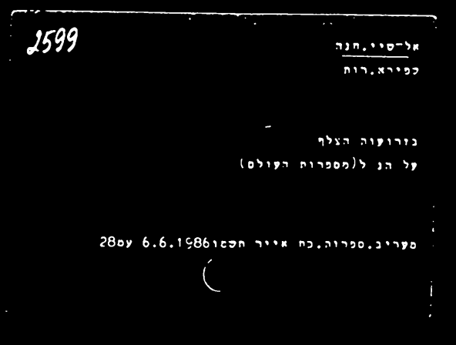
Paragraph Detection Algorithm
The noisy image is filtered, converted to grayscale, blurred with Gaussian blur, and then processed with Otsu's thresholding to create a negative binary image.

Slide 10
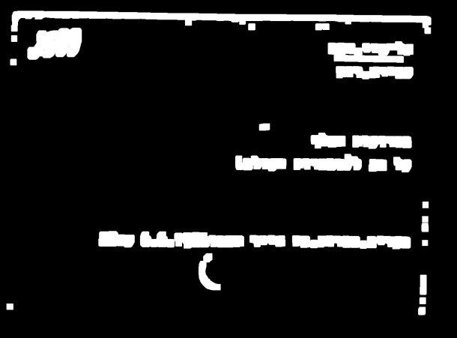
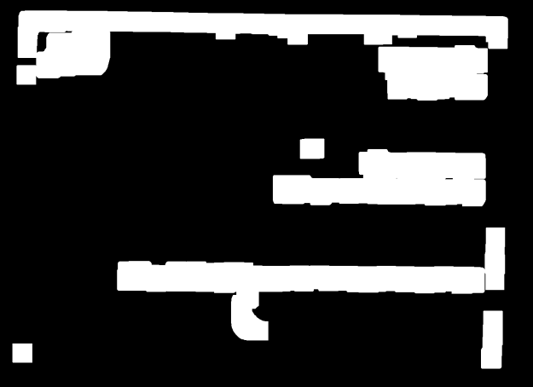
Paragraph Detection Algorithm
The method dilates a thresholded image to merge nearby contours, checks for close bounding rectangles, and iterates until all closely positioned rectangles are separated.

Slide 11
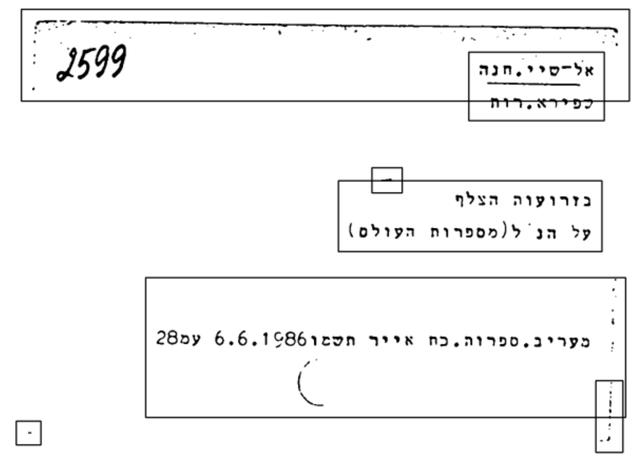
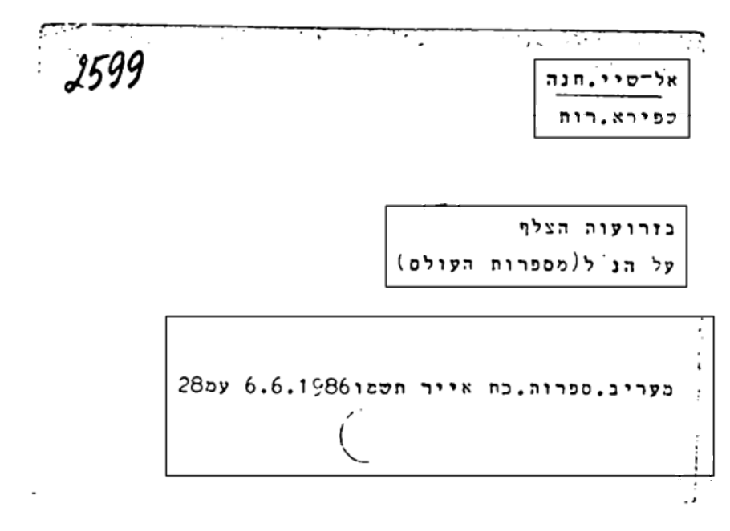
Paragraph Detection Algorithm
After the rectangles are found, they are cropped and then filtered to remove rectangles with no text inside.

Slide 12
Text Extracted From Detected Paragraphs
Values | Data Extracted
צלף עלהנ"ל(מספרות מעריב,ספרות.כת אייר .תש | OCR All Text (No Preprocessing)
Preprocessing
Values | Data Extracted
- ;- אל-סיי,חנה כפירא,רות בזרועוה הצלף לֶל הנ ל(מספרות העולם) מעריב,ספרוה,כת אייר תשמו6.6.!1%986 עמ285 / - | | OCR All Text (Preprocessed)
Paragraph Detection
Values | Data Extracted
אל-סיי,חנה | OCR Written On
כפירא,רות | OCR Written By
מעריב,ספרוה,כת אייר תשמו6.6.!1%986 עמ2852|א | OCR Main Content
בזרועוה הצלף לֶל הנ ל(מספרות העולם) | OCR Additional Content

Slide 13
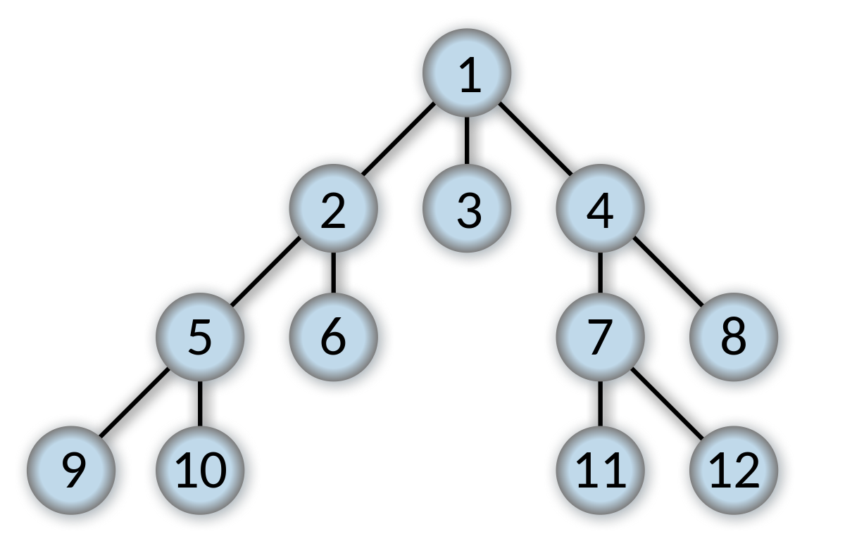
Optimizing GCP Folder Traversal with Queue Management
Problem: Inefficient Folder Traversal Previously, the code started from the same root folder for every run, traversing the entire GCP directory structure each time. It ignored already processed files, leading to increased and unnecessary processing time for larger datasets.
Solution: Queue-Based BFS Traversal Implemented a queue CSV file to remember where the last run left off, allowing the next process to resume from that point. This change required integrating the queue system into the current code, adjusting its logic, and thoroughly testing to ensure functionality.

Slide 14
Optimizing GCP Folder Traversal with Queue Management
Results: Significant Time Efficiency Gains
Before Improvement: The process took 547 minutes to process 923 files.
After Improvement: With the new queue system, processing 145 files took only 6.8 minutes.
Analysis: If the code improvement had no effect, we'd expect 90 files to take approximately 54.4 minutes based on previous performance. The significant reduction to just 6.8 minutes showcases the vast improvement and efficiency gained with this update.

Slide 15
Upcoming Tasks
Improve OCR (ensemble? Tuning?)
integrate the ParagraphDetector class to improve the OCR process, and fix: overlapping rectangles.
Compare Base improvement of OCR using Folder Metadata.
Classifying Handwriting and Typed Text
Run Over All data and create unify CSV
Schema and Entity of DB building.
Performance Evaluation with no labels (confusion matrix?)

Slide 16
The End Thank you, Any Questions?

